Slide 1

STUDENT MANAGEMENT SYSTEM
A Project By-
Tejaswini P
Konika Gupta
Yuvaraj Soman
Dawood Ibrahim
Guided by Mrs. Tandra Paul

Slide 2

CONTENTS
Introduction
Abstract
Objectives
Existing System
Proposed System
Project Category
Requirements
Tools
Users
Workflow
Database
Output
Conclusion

Slide 3
INTRODUCTION
Student Management System can handle all the details about a student. The details include students personal details and academic details etc.
The student management system is an automated version of manual Student Management System.

Slide 4
ABSTRACT
Student Management System is a software which is helpful for students as well as the management authorities. In the current system all the activities are done manually. It is very time consuming and costly. Our Student Management System deals with the various activities related to the students.
In this software, we can register as a user and user is of two types, student and admin. Admin has the power to add a new student, can edit student’s details, delete a student and can view all the student’s details. A student can register as a user and can view his/her profile along with all other student’s details.

Slide 5
OBJECTIVES
Student Management System is an information management system for education establishments to manage student’s data.
It provides capabilities for tracking students academic details and personal details.
It ensures data integrity, privacy, and security in an open-access environment.

Slide 6

EXISTING SYSTEM
System Analysis is a detailed study of the various operations performed by a system and their relationships within and outside of the system.
During analysis, data collected on the various files, decision points and transactions are handled by the present system. The commonly used tools in the system are Data Flow Diagram, interviews, etc. Training, experience and common sense are required for collection of relevant information needed to develop the system.
In the current system we need to keep a number of records related to the student and want to enter the details of the student and the marks manually. In this system only the teacher or the school authority views the mark of the student and they want to enter the details of the student. This is time consuming and has much cost.

Slide 7

PROPOSED SYSTEM
In our proposed system we have the provision for adding, modifying, deleting and viewing the details of the students by admin.
So the overhead of the management authorities and the teachers is become less.
Another advantage of the system is that , students can view their academic and personal details.
The marks of the student are added in the database and so students can also view the marks whenever they want.
All the manual difficulties in managing the student details have been rectified by implementing computerization.

Slide 8
Our proposed system has several advantages:
User friendly interface
Access to database
Less errors
Look and Feel Environment
User Authentication
Time efficient

Slide 9
PROJECT CATEGORY
Our student management system is a console application.
It is an application that uses the command line for input and output rather than a graphical user interface (GUI).
Console applications are light weight programs run inside the command prompt (DOS) window. They are commonly used for test applications.

Slide 10
REQUIREMENTS
Hardware Requirements:
Processor: Intel P-IV System
Processor Speed: 250 MHz to 833 MHz
Ram: 512 Mb Ram
Hard Disk: 40 Gb
Software Requirements:
Windows/any OS capable of running C++
DEV C++
XAMPP SERVER
CODEBLOCKS

Slide 11



TOOLS USED

Slide 12


USERS OF THE PROJECT
ADMIN
STUDENT

Slide 13
WORKFLOW
STUDENT MANAGEMENT SYSTEM
Admin login
Student login
Student management module
Student management module
Add student details
Modify student details
Delete student details
View student details
View details
Quit module
Quit module

Slide 14

DATABASE TABLE CONTENTS
STUDENT
NAME
STUD_ID
AADHAR
GUARDIAN
COURSE
DURATION
FEE
MARKS
GENDER
PHONE
EMAIL
LOCATION

Slide 15
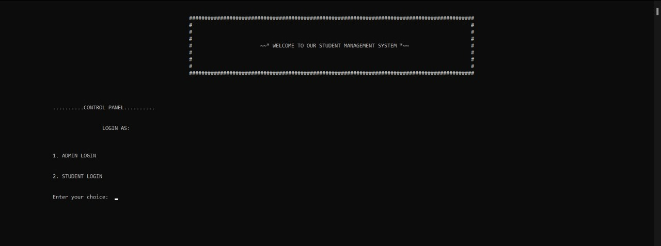
OUTPUTS
CONTROL PANEL:

Slide 16
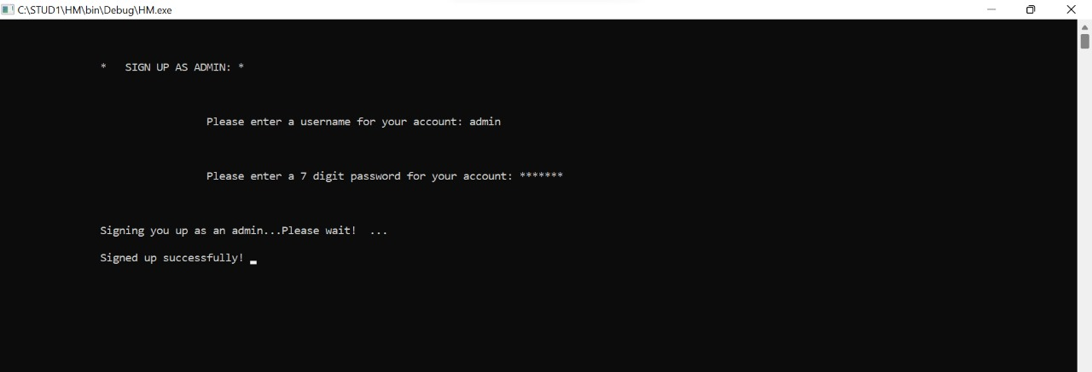
ADMIN REGISTRATION:

Slide 17
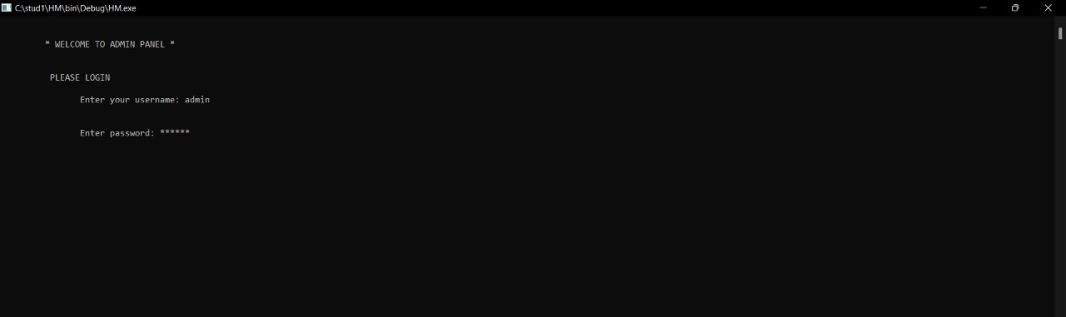
ADMIN LOGIN:

Slide 18
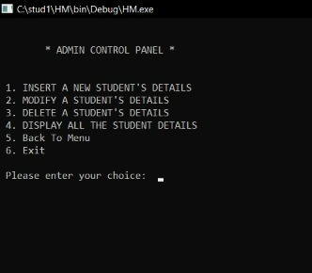
ADMIN CONTROL PANEL:

Slide 19
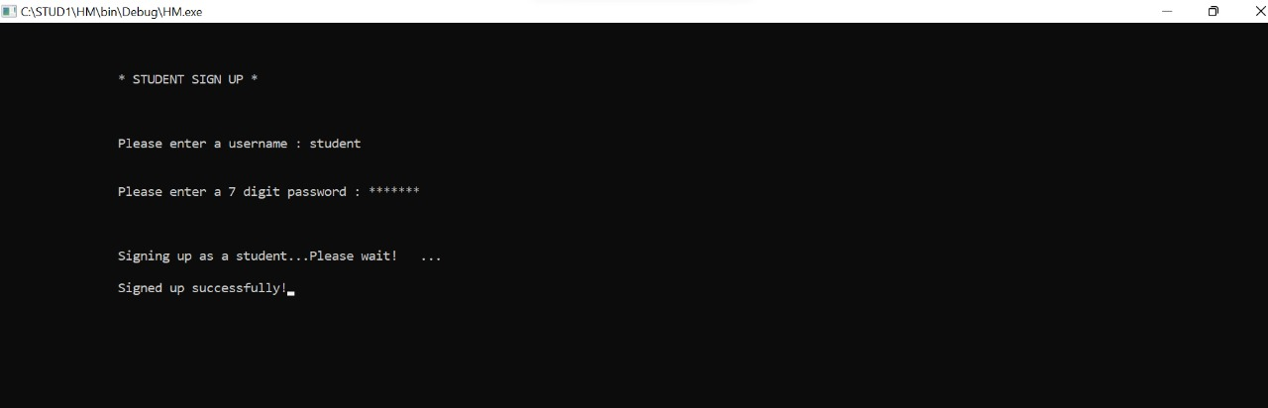
STUDENT REGISTRATION:

Slide 20
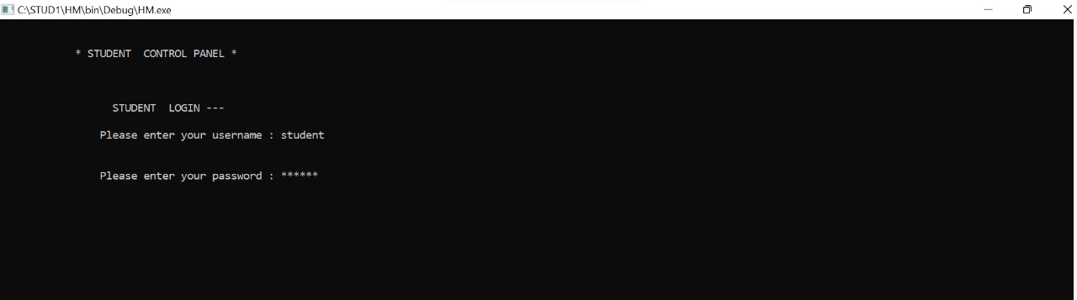
STUDENT LOGIN:

Slide 21
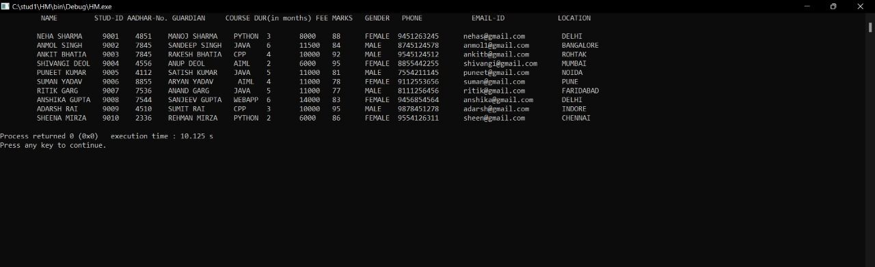
ALL STUDENTS’ DETAILS:

Slide 22
CONCLUSION
Student Management System can be used by educational institutions to maintain their student records easily. Achieving this objective is difficult using the manual system as the information is scattered, can be redundant, and collecting relevant information may be very time-consuming. All these problems are solved by this project.
This system helps in maintaining the information of pupils of the organization. It can be easily accessed by the manager and kept safe for a long period of time without any changes.

Slide 23

ANY QUESTIONS?

Slide 24


